Slide 1
iPromptU
Introductory Tutorial
Duyen B. Vo, Ph.D. and Bradford C. Richards, Ph.D., ABPP
Cognitive Behavioral Institute of Albuquerque, NM, USA
Email: br@cogtherapy.com

Slide 2
History
In 2012, it became clear that mobile devices were here to stay, and that they were theoretically capable of delivering individually customized therapy homework
At the Cognitive Behavioral Institute of Albuquerque, we set out to create the first App capable of doing this, on both Apple and Android
In early 2013, we had a working prototype of iPromptU
In May 2013 I showed Prof. Adrian Wells the prototype while at the 2nd International Conference of Metacognitive Therapy in Manchester
In 2016 we added the ability to display multiple questions on a single form, enabling the replication of virtually any pencil and paper worksheet
In January 2019, we first implemented “import/export” functionality for settings, enabling large-scale dissemination of research protocols

Slide 3
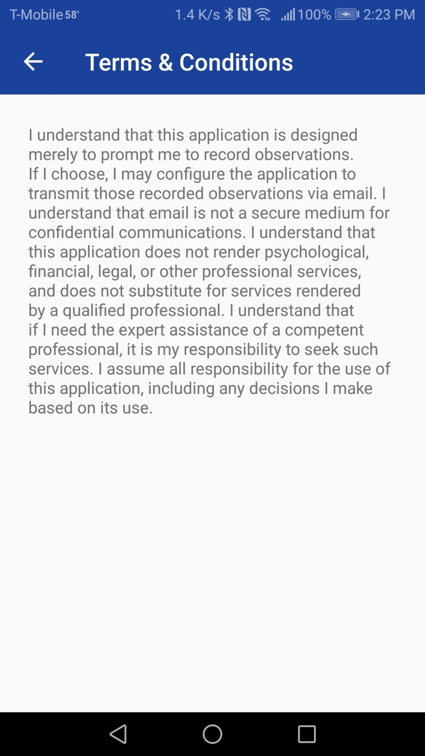
Preliminaries: Terms of Use, with consent to use email

Slide 4
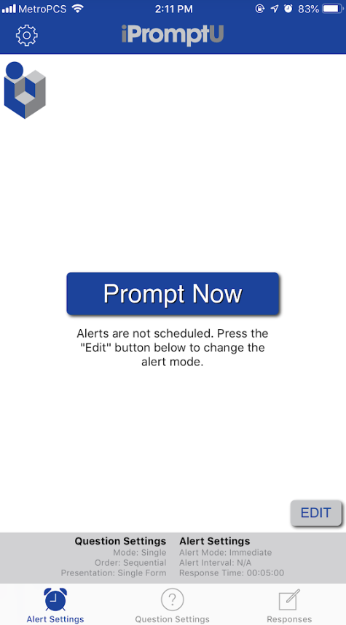
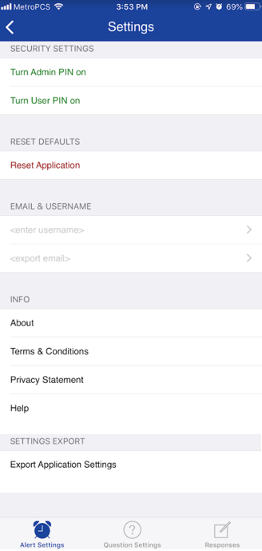
App Settings
Please enter a username now
Please enter your email address now

Slide 5
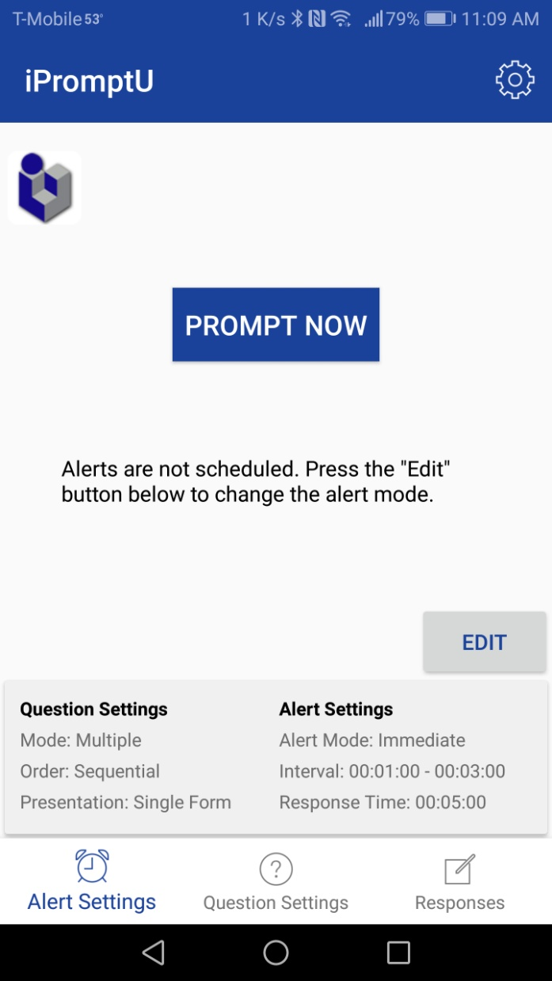
Home Screen: Apple iOS and Android, “Immediate” mode

Slide 6
Home Screen: Customizing Options

Slide 7
Most commonly used functions:
Adding and editing your own questions

Slide 8
Changing “Question Settings”: Click “Question Settings”

Slide 9
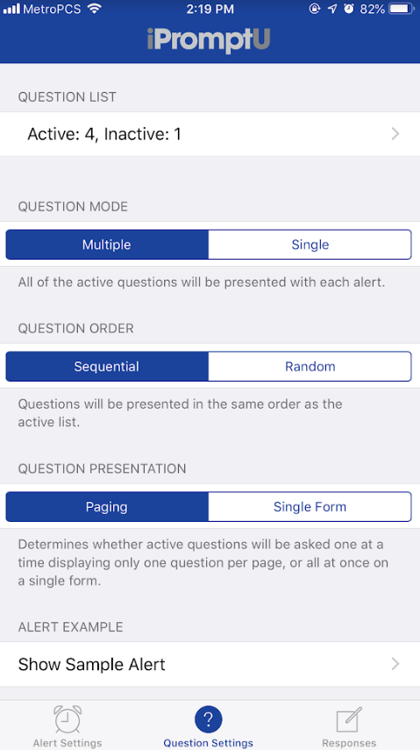
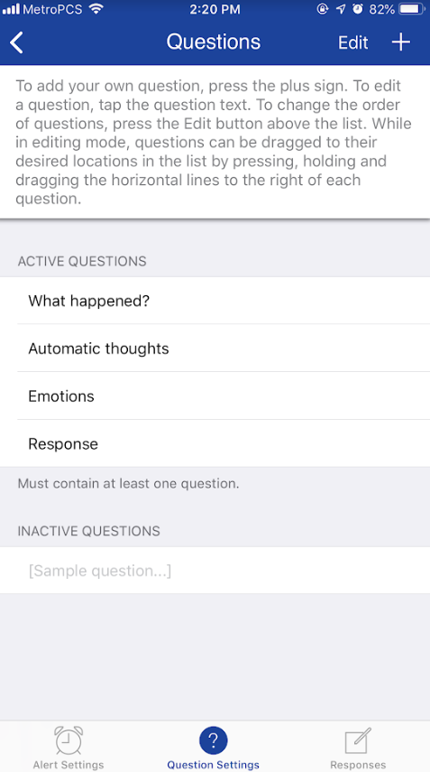
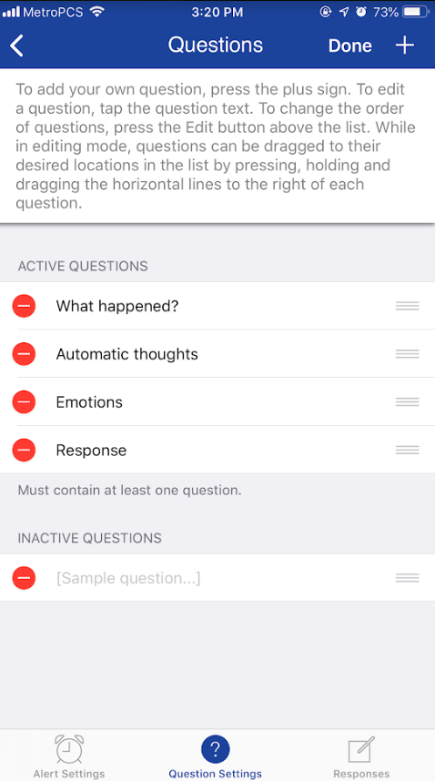
Editing Questions in Apple iOS
To delete
To change order of questions

Slide 10
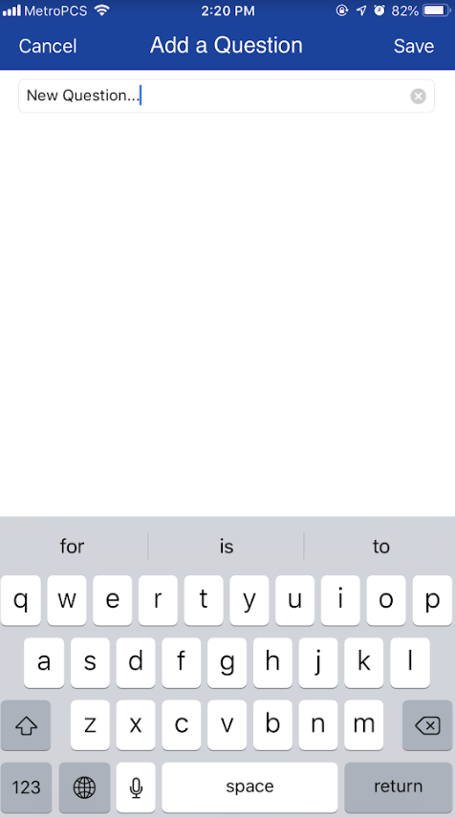
Adding new Questions in Apple iOS

Slide 11
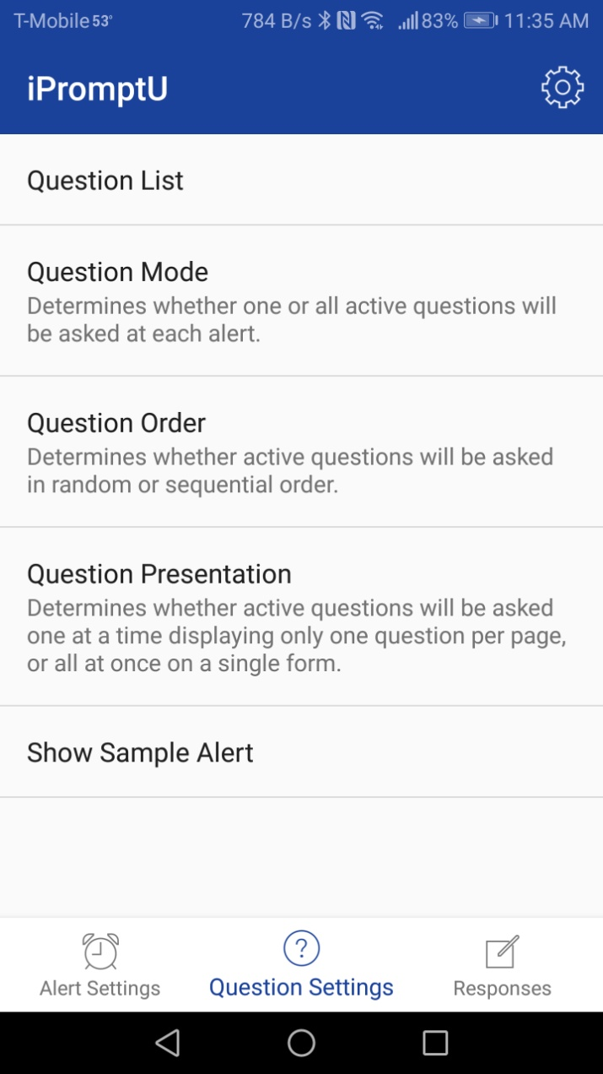
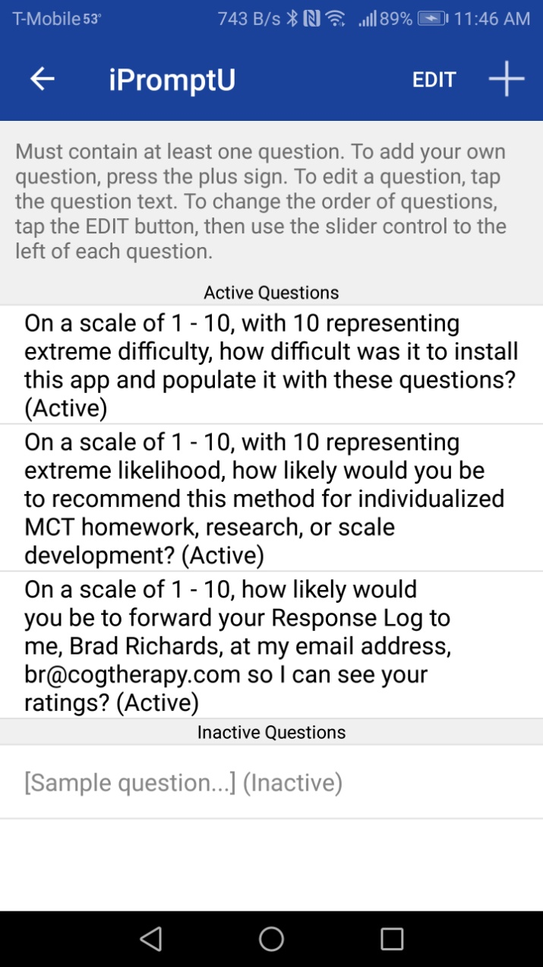
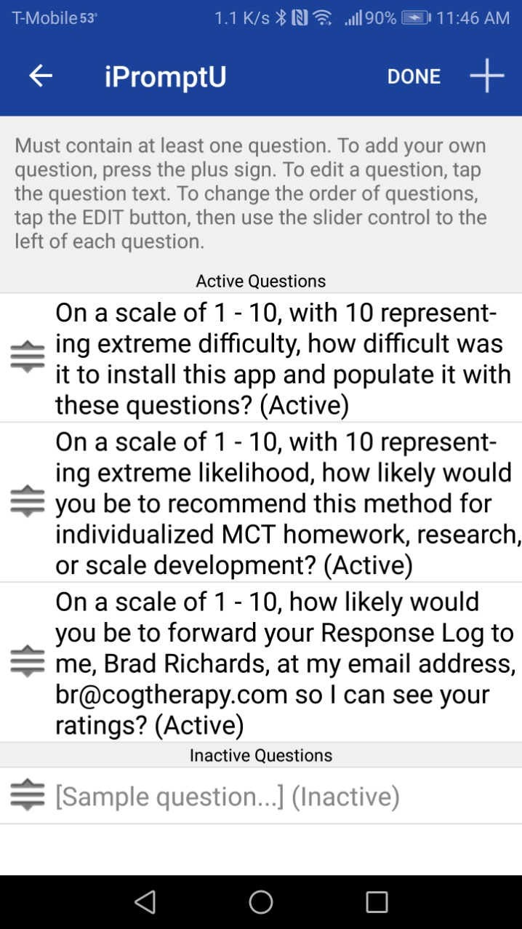
Editing Questions in Android
Press, hold, and drag sliders to re-order questions
Tap any question to edit it or delete it

Slide 12
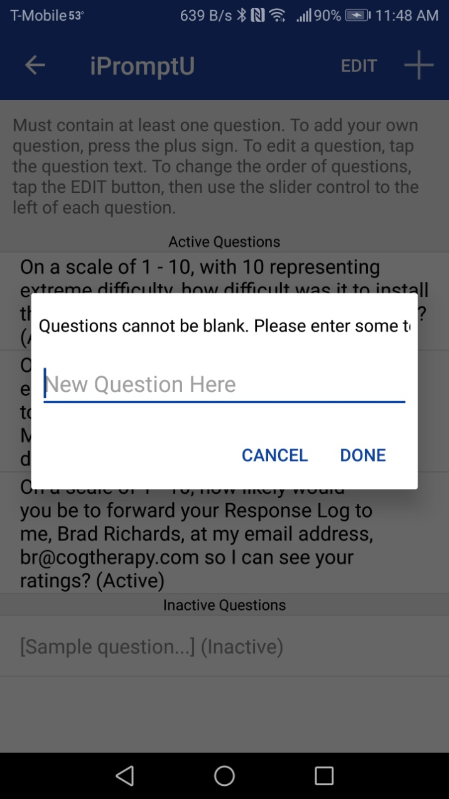
Adding new Questions on Android

Slide 13
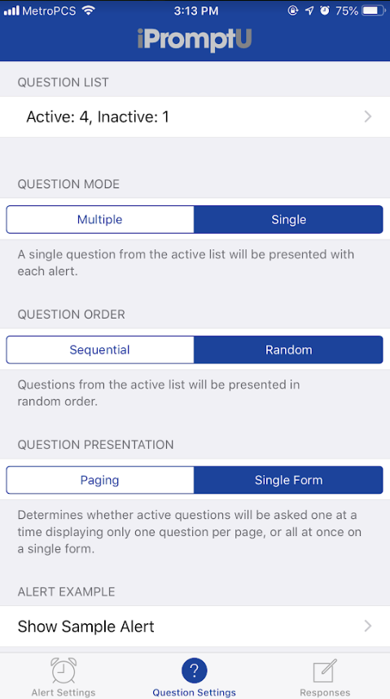
Other changes to “Question Settings”

Slide 14
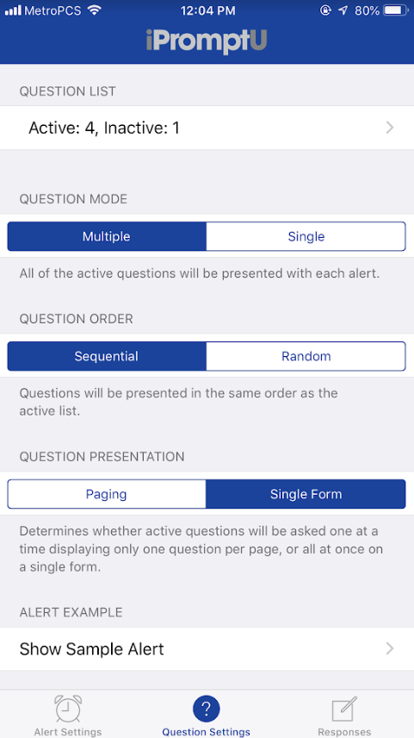
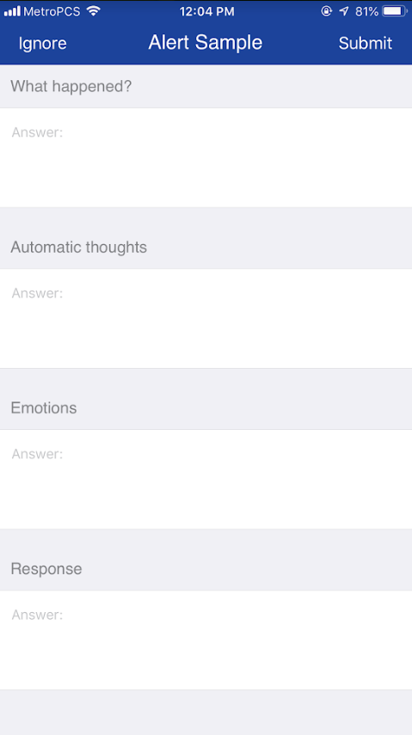
Changing “Question Settings”

Slide 15
More advanced functions:
Changing Alert Settings
(Suggestion: don’t do it unless you know you really need to)

Slide 16
Changing “Alert Settings”: Click “Edit”

Slide 17
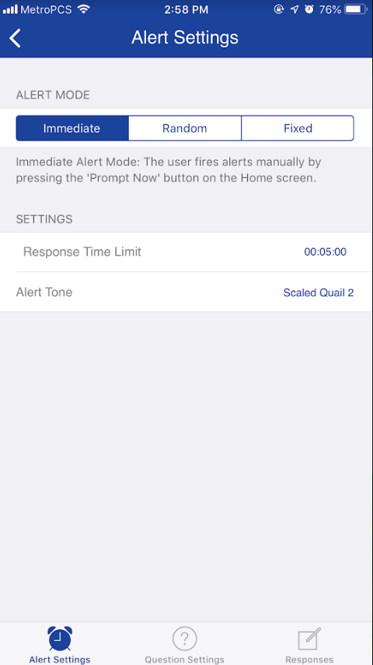
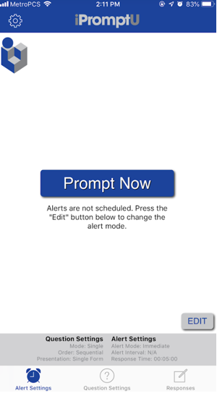
Changing “Alert Settings” Apple

Slide 18
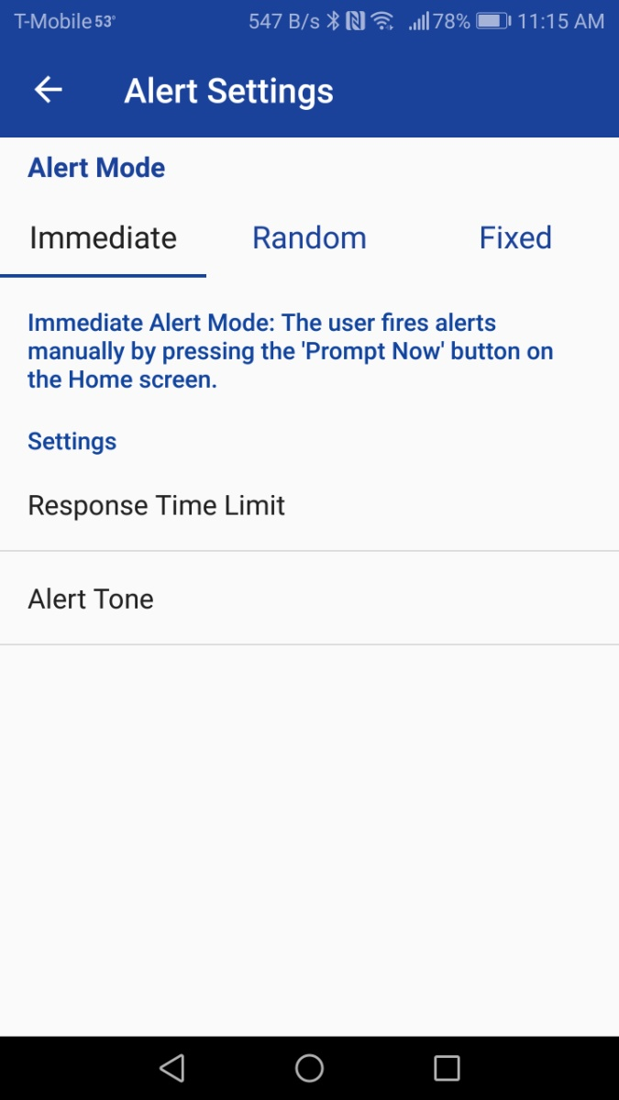
Changing “Alert Settings” Android

Slide 19
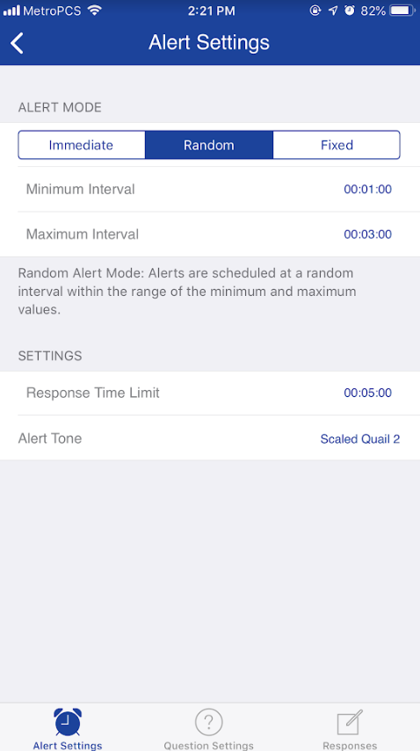
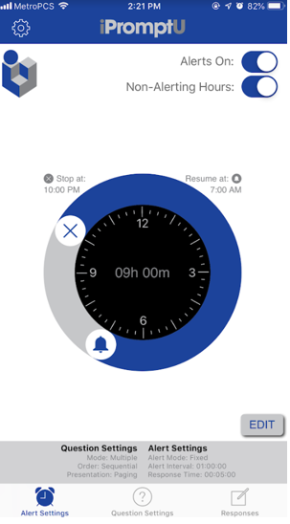
Changing “Alert Settings”
Adjustable timeframe for Non-Alerting Hours

Slide 20
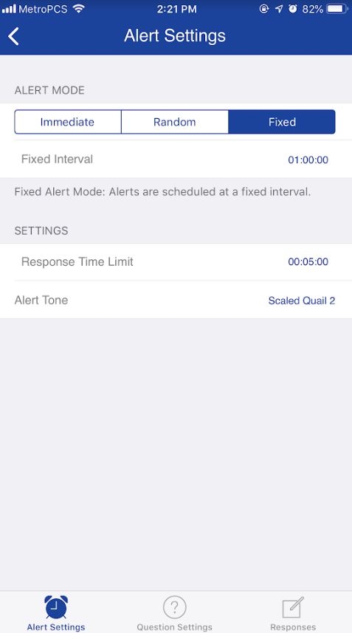
Changing “Alert Settings”
Adjustable timeframe
Adjustable timeframe for Non-Alerting Hours

Slide 21
Accessing “Responses”: Click “Responses”

Slide 22
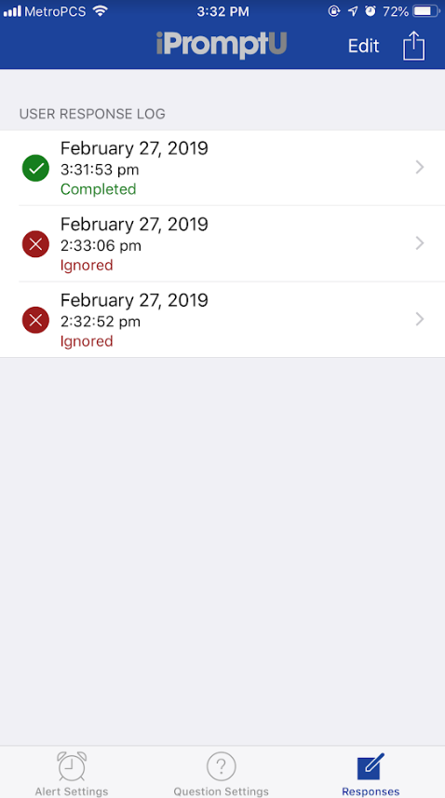
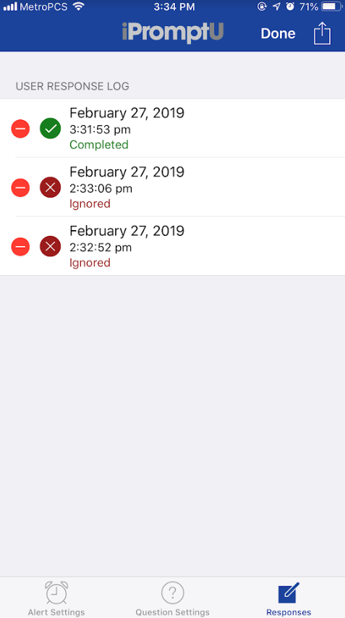
Accessing “Responses”: Deleting Response Entries - Apple
To delete

Slide 23
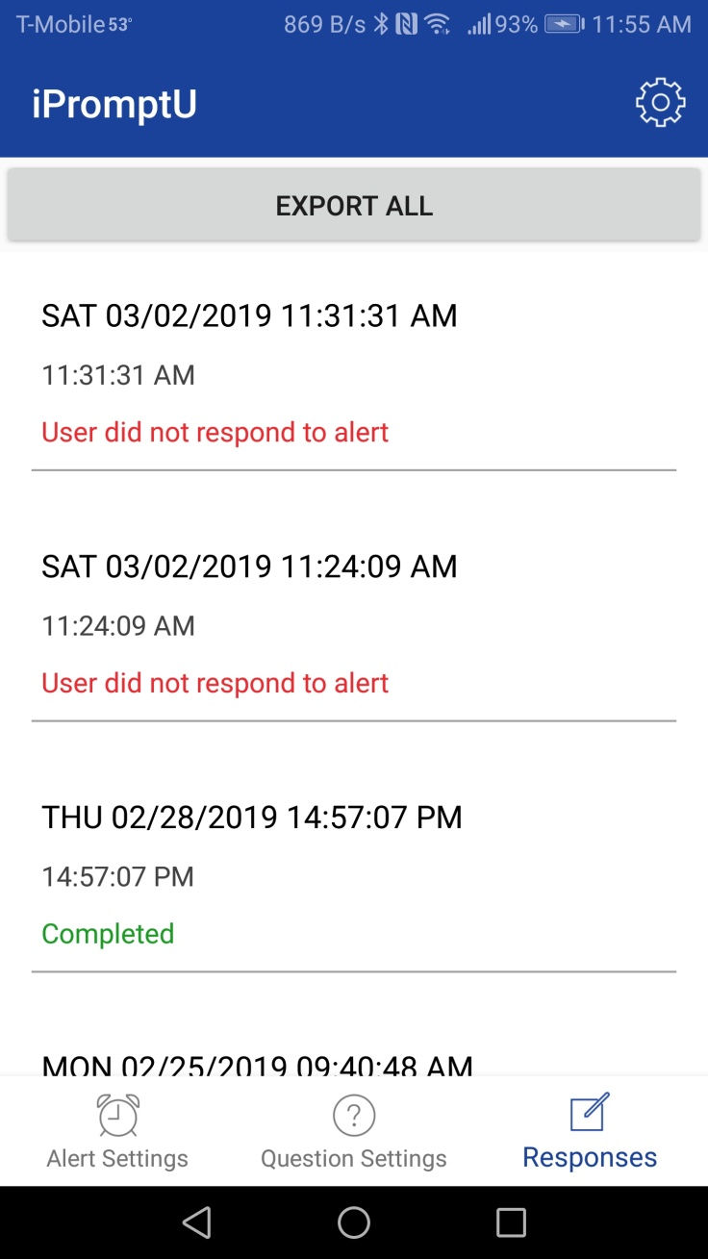
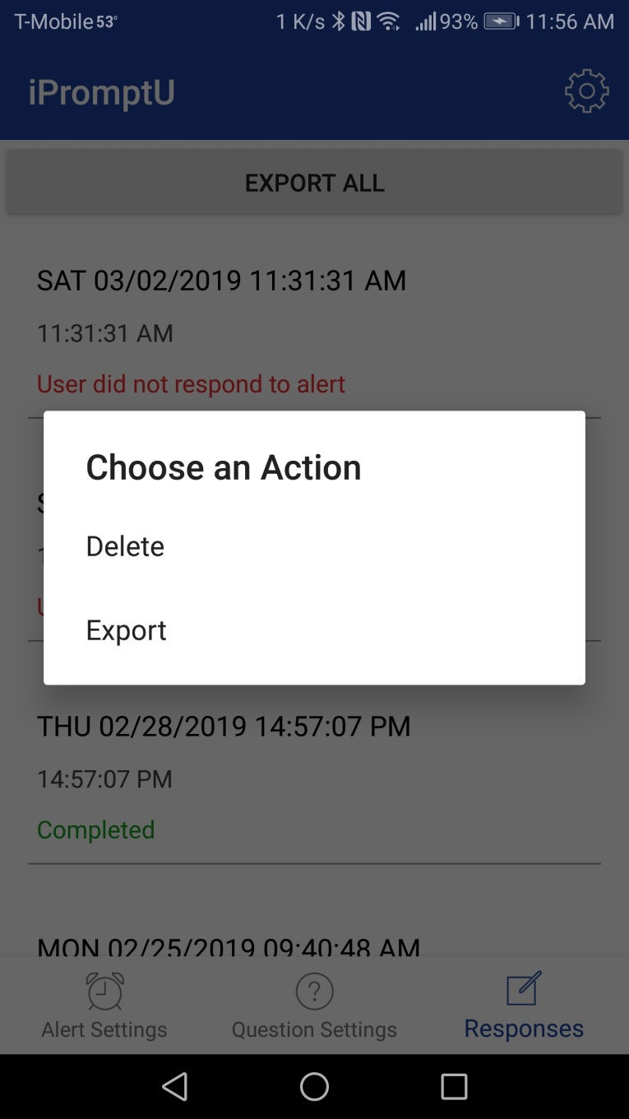
Accessing “Responses”: Deleting Response Entries - Android
Press & hold
To delete

Slide 24
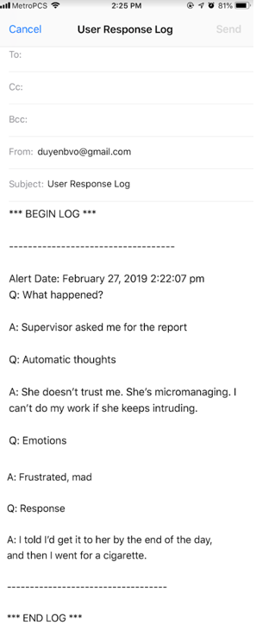
Accessing “Responses”: Emailing Response Entries in Apple

Slide 25
Accessing “Responses”: Emailing Response Entries in Android

Slide 26
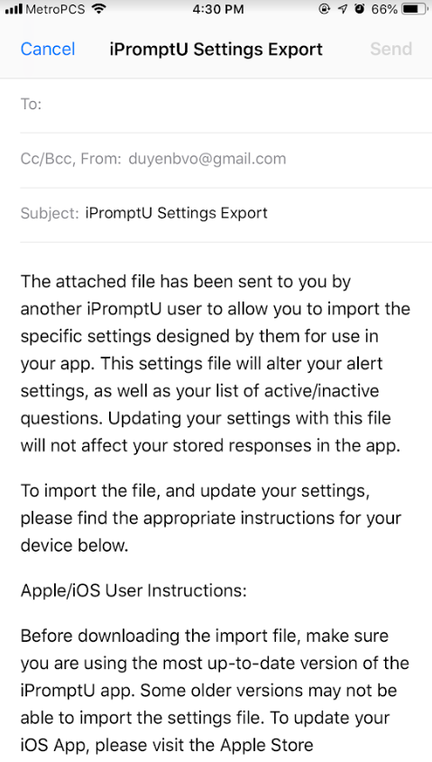
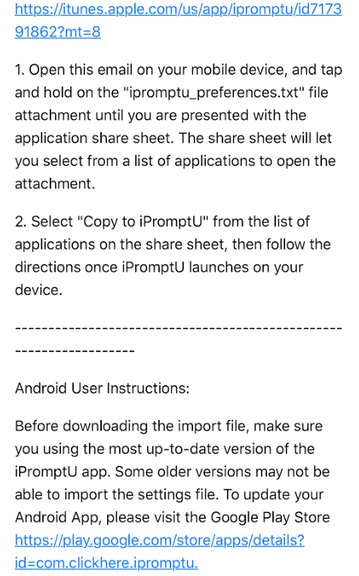
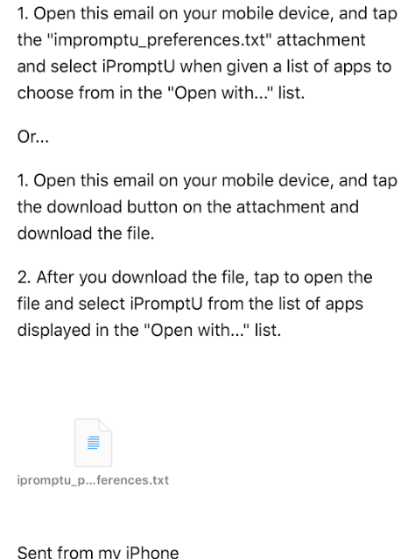
App Settings
Research utility

